Slide 1
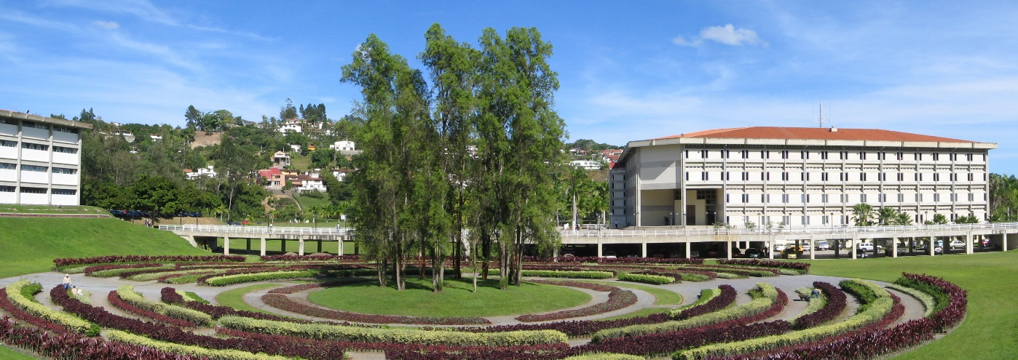

Universidad Simón Bolívar

Slide 2
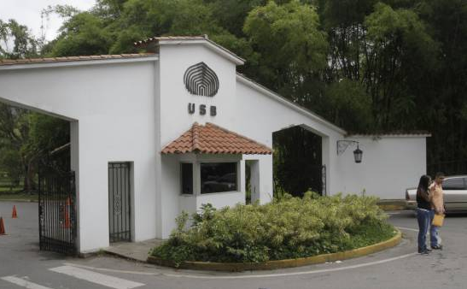
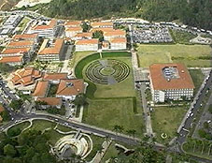

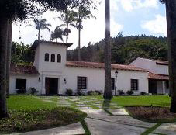
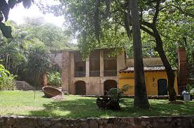
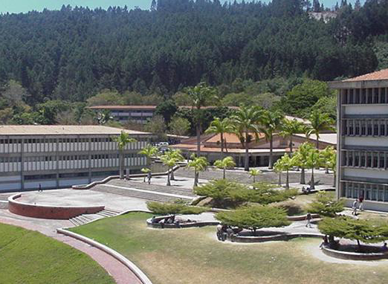
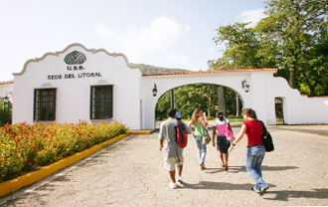
FOUNDED IN 1969
ENRIQUE PLANCHART RECTOR
LUIS HOLDER
ACADEMIC VICE RECTOR
MARIELLA AZZATO ADMINISTRATIVE VICE RECTOR
CRISTIAN PUIG SECRETARY
ALBERTO ARMENGOL
DIRECTOR OF THE LITORAL CAMPUS

Slide 3
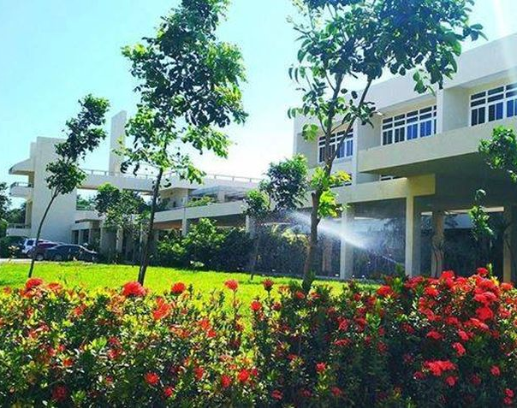
History, location and setting
Founded on July 1967, USB started academic activities on january 19, 1970 in its main campus, Sartenejas (Caracas)
On february 12, 1977 campus El Litoral, located on the central coast, was inaugurated
Both campuses are set in sub-urban ares, with extensive forests and parks (over 260 hectars of land, more than 20m² per person)
Until July 2019, the university has awarded around 36000 undergraduate degrees and about 5000 graduate degrees
USB graduates enjoy high employability around the world
Universidad Simón Bolívar

Slide 4
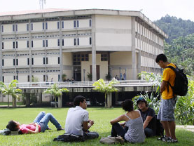
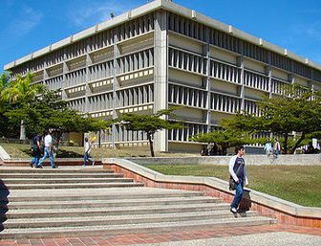
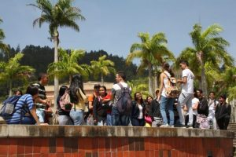

studies
studies
The university offers:
Associated degrees (3 years)
Undergraduate degrees (5 years)
Master of Science degrees (2-3 years)
Specialization degrees (2-3 years)
Doctorate degrees (4-5 years)
Continuing education
The academic year divided in three periods of 12 weeks each:
September-December
January-March
April-July
During August, summer school is offered
Universidad Simón Bolívar

Slide 5
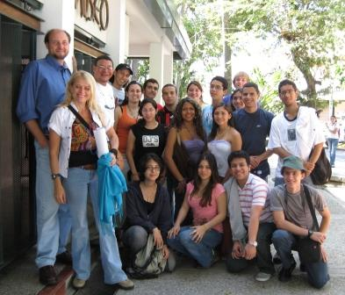
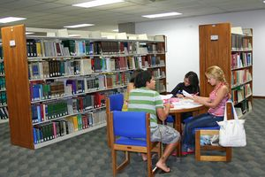
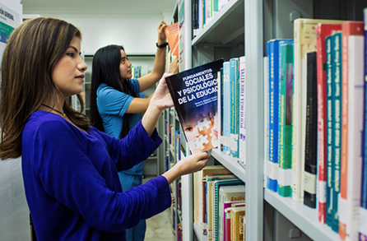
studies
Study programs for all majors include:
Theory lectures
Practice sessions
Laboratories
General Studies
Internship or thesis
Community Service
Laboratories are an essential part of the curricula, and aim to provide students not only with the theoretical knowledge, but also with the practical experience. Project Based Learning is a common practice.
General Studies comprise courses in general areas of knowledge and are aimed to provide students with the necessary soft skills to become responsible citizens, with an ethical, analytical and conscious attitude towards society, environment and culture.
General Studies are compulsory, comprise around 20% of the total credit units, and represent a distinctive feature of our graduates.
Universidad Simón Bolívar

Slide 6



undergraduate
degrees
BACHELOR DEGREES IN ENGINEERING
Computer
Materials
Electrical
Electronical
Geophysical
Mechanical
Production
Chemical
Telecommunications
Maintenance
BACHELOR DEGREES IN BASIC SCIENCES
Biology
Physics
Mathematics
Chemistry
BACHELOR DEGREES IN SOCIAL SCIENCES
Architecture
Urban planning
Hospitality
International Trade
Liberal Arts
Economy
ASSOCIATED DEGREES
Tourism Administration
Hotel Administration
Transport Administration
Customs Administration
Business Organization
International Trade
Electrical Technology
Electronic Technology
Mechanical Technology
Aeronautical Maintenance

Slide 7
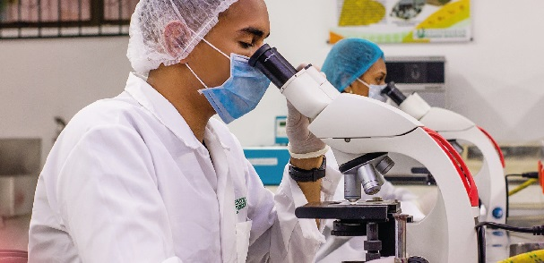


graduate degrees
Master Degrees
ENGINEERING AND TECHNOLOGY
BASIC AND APPLIED SCIENCIES
SOCIAL SCIENCES
URBAN PLANNING
BUSSINES
Biochemistry
Earth Science
Mechanical Eng
Systems Eng
Materials Eng
Electronic Eng
Electrical Eng
Chemical Eng
Statistics
Philosophy
Psychology
Political Sciences
Applied Linguistics
Music
Education
Environment and Development
Mathematics
Biological Sciences
Physics
Nutrition
Food Science
Computer Science
Urban Transport
Business Administration
Over 30 Specializations

Slide 8

graduate studies
Doctorates
ENGINEERING AND TECHNOLOGY
BASIC AND APPLIED SCIENCIES
SOCIAL SCIENCES
URBAN PLANNING
Engineering
Philosophy
Latin-American Literature
Political Sciences
Sustainable Development
Social Sciences and Humanities
Mathematics
Biological Sciences
Physics
Chemistry
Nutrition
Food Science
Computer Science
Interdisciplinary Sciences
Urban Transport

Slide 9
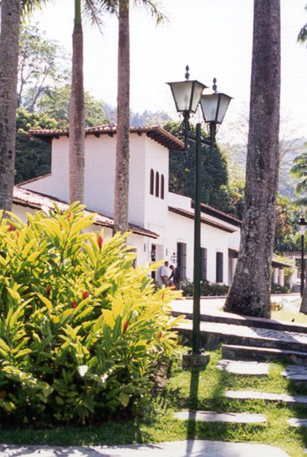

Universidad Simón Bolívar is a gender balanced HEI

Slide 10

Faculty
Total academic faculty staff 613 (2018)
54% of full time professors have PhD
Faculty is gender balanced
Responsibilities of faculty:
Teaching
Research and Development
University Outreach

Slide 11

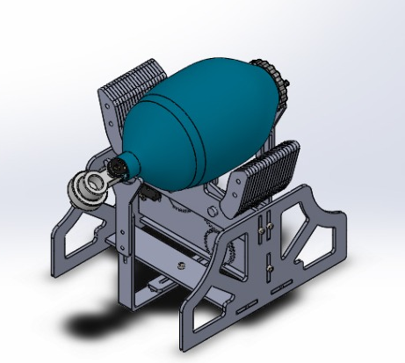
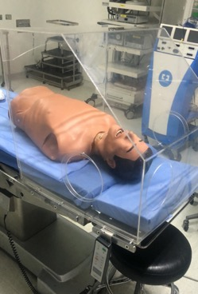
Social responsibility
COVID 19 Response
Design and construction of a respirator prototype, based on the MIT modelª
Design and construction of the “Cube de Vie,” a redesign of the “aerosol box” aimed to reduce the health care provider’s risk of infection while working with COVID 19 patients^{b}
Design and construction of electrolytic hypochlorite solution generators, for disinfection purposes
Distribution of electrolytic hypochlorite generators to 12 health care institutions
Donation of hypochlorite solutions to public health care institutions
ª Project developed in cooperation with Clíinica Metrolopitana
^{b} Project developed with cooperation of Hospital de Clínicas Caracas

Slide 12


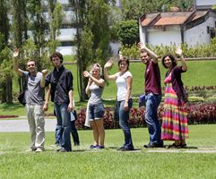
internationalization
2001: Creation of the International Relations and Cooperation Office
Since 2001: Successful Student Exchange Program
Since 2013:
Efforts towards comprehensive internationaliza-tion
Vision:
International dimension in al aspects of university life
Cooperation agreements with over 100 universities in more than 25 countries
Member of 8 international networks
Participation in several cooperation programs
Capacity building and mobility projects through ERASMUS+

Slide 13
internationalization
Dimensions of the internationalization
Education
Visibility and marketing
Internationali-zation of the curriculum
Shared courses
R&D
Student
Organizations
Ranking systems
Web page
Cooperation agreements, joint research projects and publications, Visitng Scholar programs
Support for international activities, engagement of incoming exchange students
Strategic partnerships
Mobility
Engagement in strategic networks
Increase graduate student, faculty and staff mobility
Outreach
Continuing education (on-line)
International consulting services

Slide 14

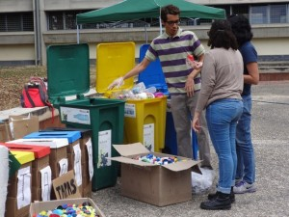
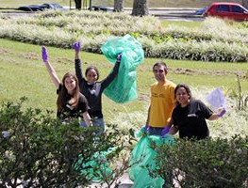
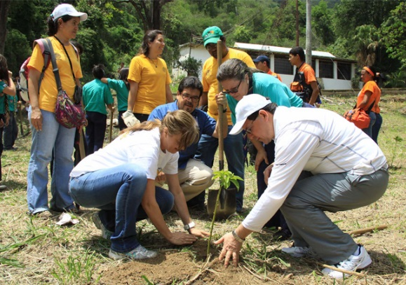


Sustainable campus
Member of REDVUA and ARIUSA
Participation in Green metrics
Extensive recycling program
Some Smart building implementation
Paperless policy
Electronic signature policy
Free shuttle service for students, faculty and staff
Program for promotion of bicycle use
Over 150 courses related to environment and sustainable development offered
Forest protection program
Community service projects related to environment and sustainable development
Five student organizations related to environment and sustainable development

Slide 15
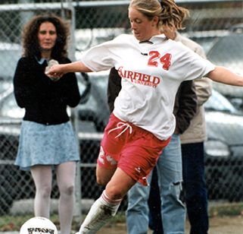
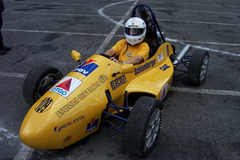
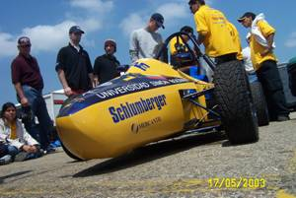
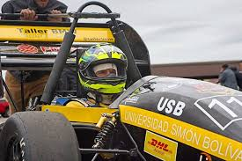
Over 50 student organizations are active in the university. The clubs range from sports and recreational activities such as rugby, scuba diving, mountaineering, surf and windsurf, to academic, cultural and scientific interests such as languages, science fiction, music, cinema, theater and astronomy.
student activities
MODEL UNITED NATIONS
USB participates in HMUN, LAMUN and WMUN. Students prepare themselves comprehensively, and have an excellent performance in the competitions
HMUN 2017: Outstanding Large Delegation
LAMUN 2017: Best large Latinamerican Delegation
WMUN Feb. 2017: Best large Delegation
F-SAE USB PROJECT
The Society of Automotive Engineers (SAE), holds an annual competition for college students which consists of designing and building formula cars following a set of rules.
Best performance achieved in 2006: place 24 among 120 universities.

Slide 16













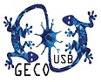











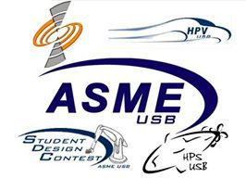











student activities
student activities
Over 50 active student organizations

Slide 17




Special thanks to the Université de Pau et des Pays de l’Adour for the kind invitation to the 2017 International Week

